Slide 1

Life Expectancy
Prediction
Analysis
A Data Science study on what helps people live longer

Slide 2

Project
Overview
This project develops a machine learning model to analyze the key health, economic, and social factors that influence life expectancy across countries. It examines how indicators such as healthcare access, immunization, education, and income levels affect longevity worldwide.
The goal is to build a predictive system that can estimate life expectancy based on these factors and identify the most important drivers behind global differences.

Slide 3

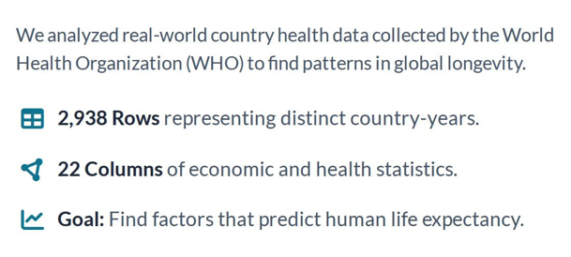
Dataset
Description

Slide 4

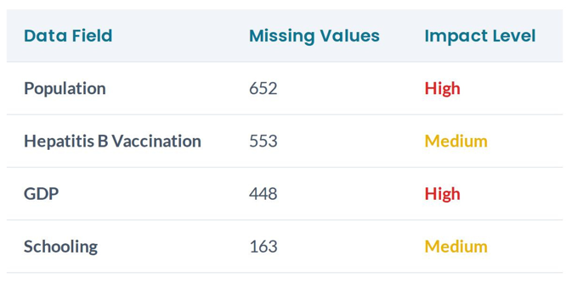
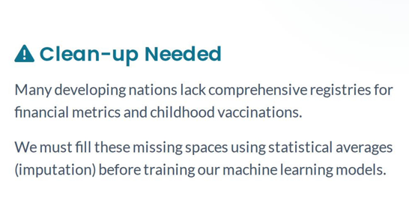
Finding
Missing Data

Slide 5

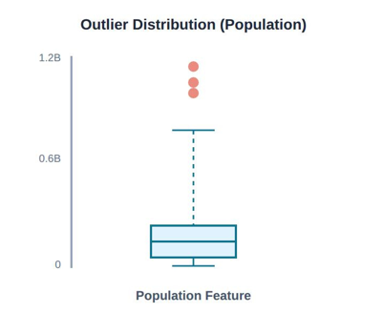
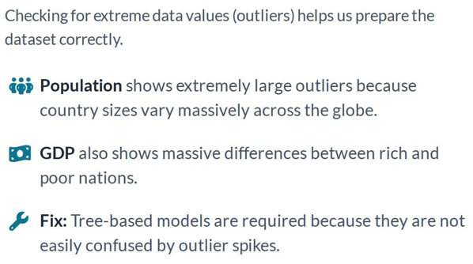
Outlier Detection
Before Cleaning

Slide 6
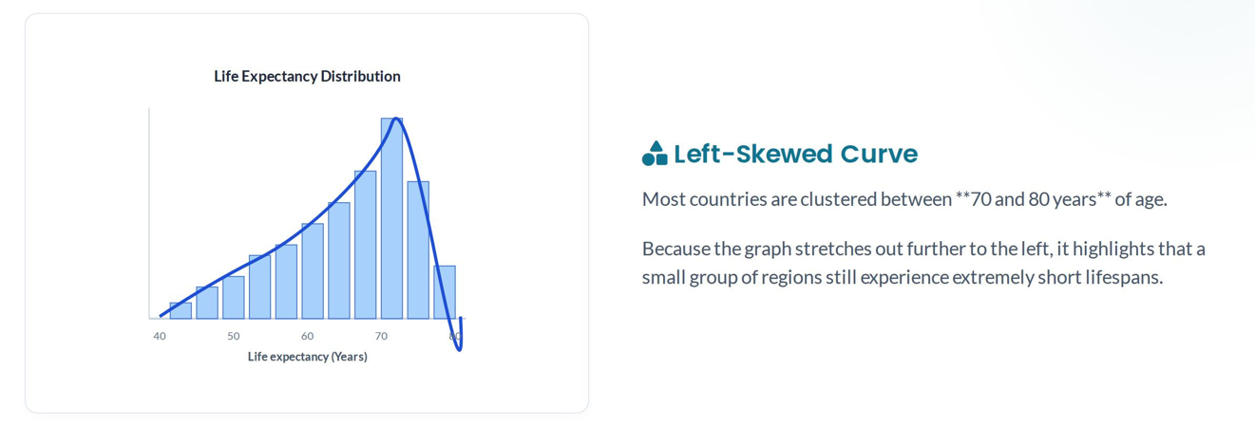
Life Expectancy
Distribution

Slide 7

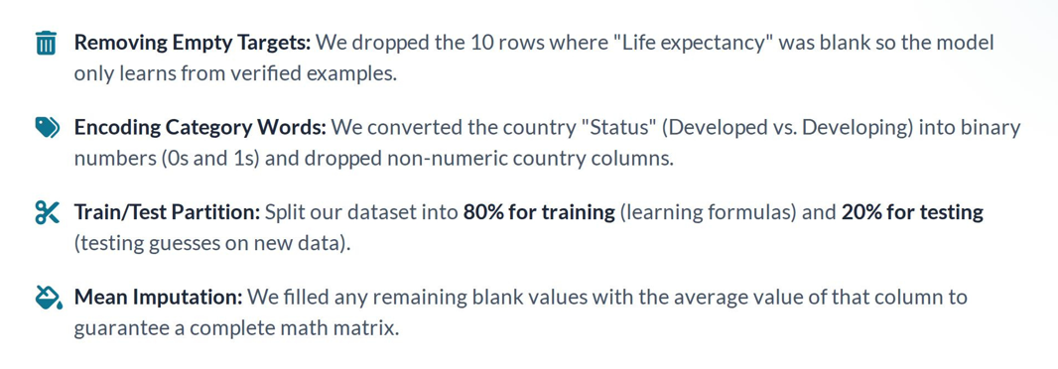
Data Cleaning &
Preparation

Slide 8

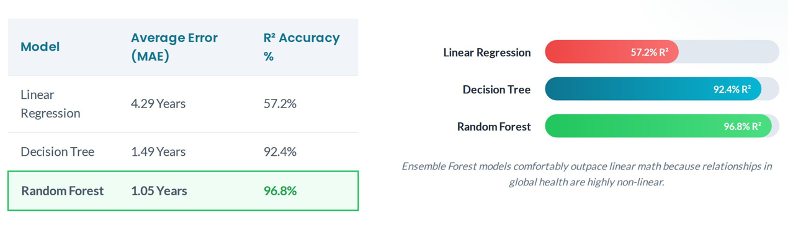

Model Accuracy
Comparison

Slide 9

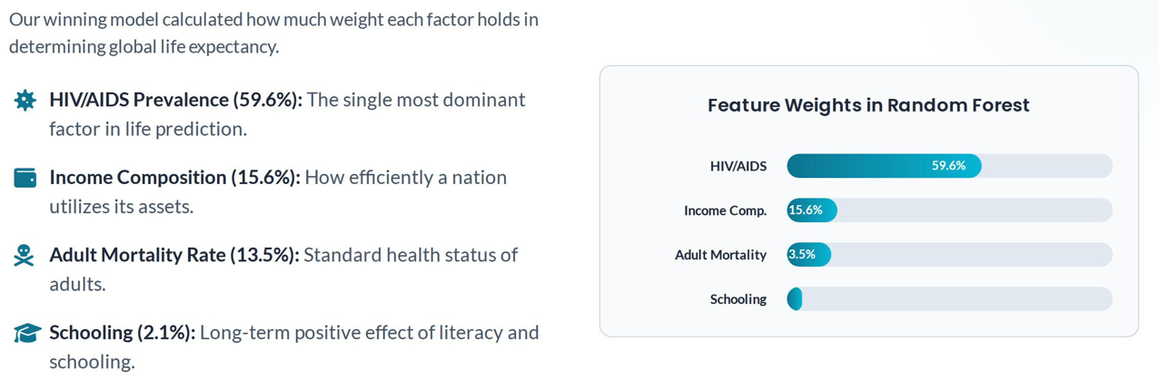
Most Important
Factors

Slide 10
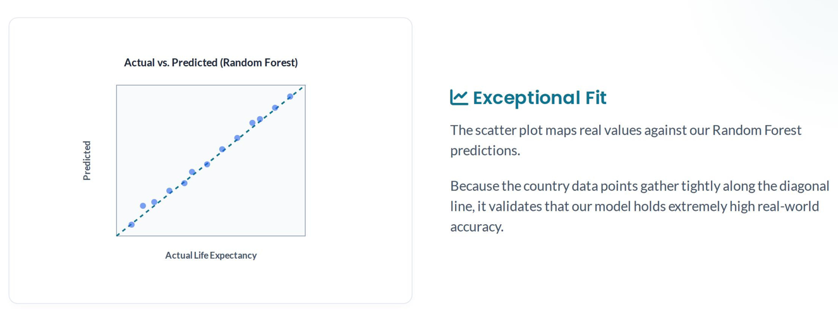
Real Values vs. Model Predictions

Slide 11

Conclusion
The Random Forest model was selected as the final model due to its high accuracy and low error rates.
Key findings show that life expectancy is strongly influenced by:
Disease prevalence (especially HIV/AIDS)
Income and education levels
Mortality rates
The final model can be used to predict life expectancy and support global health analysis.

Slide 12

Thank
You

